Slide 1
Classifying Living Things

Slide 2

Classification
Classification is the process of grouping things based on their shared traits.
Biologists use classification to organize living things into groups, so that the organisms are easier to study
The scientific study of how living things are classified is called taxonomy.

Slide 3
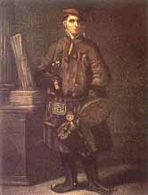
Classification System
Carolus Linnaeus is the Swedish scientist who developed a classification system based on the organisms’ observable features.
Linnaeus’s naming system is called binomial nomenclature because each organism is given a two part name.

Slide 4
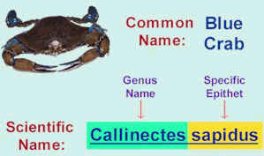
Binomial Nomenclature
The first part of the organism’s name is its genus. This is a classification grouping that contains similar, closely related organisms.
The second part of the organism’s name is its species. A species is a group of similar organisms that can mate and produce fertile offspring.

Slide 5
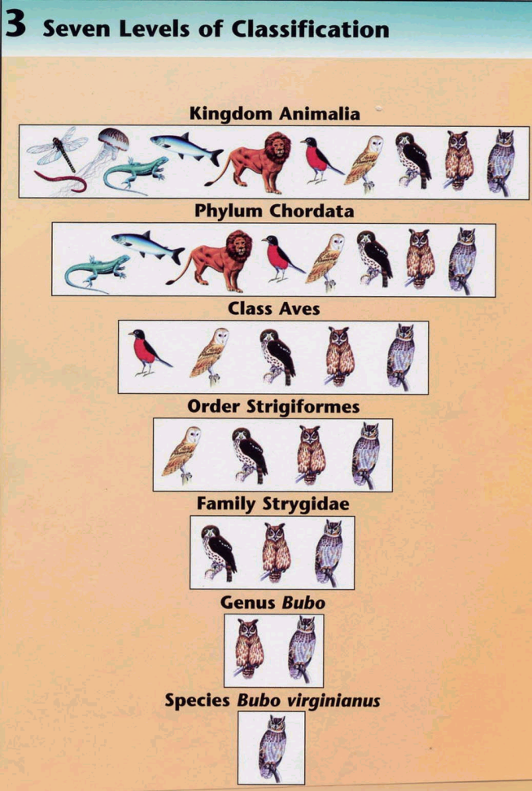
Seven Levels of Classification
Today’s classification system uses several levels to classify organisms. The more characteristics that organisms have in common, the more level they share.
  Kingdom
  Phylum
  Class
  Order
  Family
  Genus
  Species

Slide 6
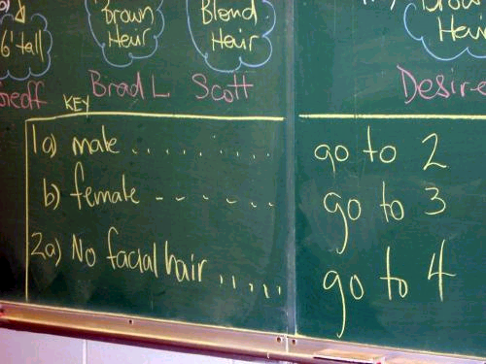
Dichotomous Keys
Taxonomist have developed special guides know as dichotomous keys to aid in identifying unknown organisms.
A dichotomous key consists of several pairs of descriptive statements that have only two responses.

Slide 7
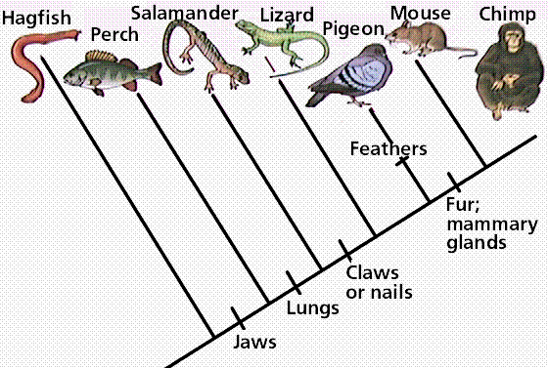
Branching Diagrams
Branching diagrams show the close evolutionary relationships between organisms.
As characteristics differ, branches in the diagram form.

Slide 8
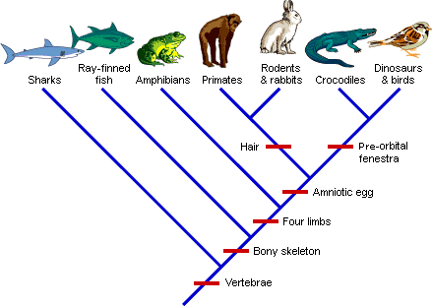
Cladograms

Slide 9
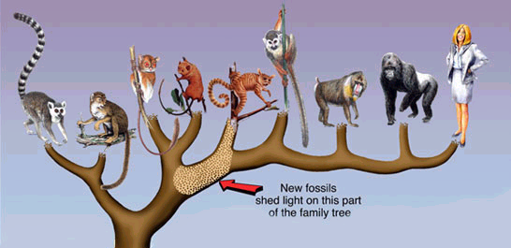
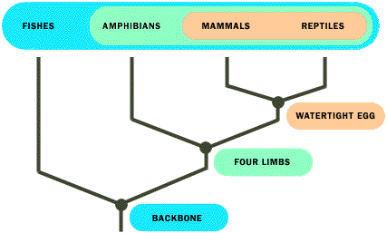

Slide 10


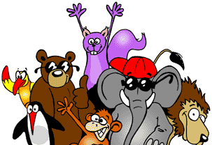




5/6 Kingdoms of Organisms
Bacteria (Monera)
  Archeabacteria
  Eubacteria
Protists
Fungi
Plants
Animals

