Slide 1
Steps of
the
Scientific Method

Slide 2
The Scientific Method involves a series of steps that are used to investigate a natural occurrence.

Slide 3
Scientific Method
Problem/Question
Observation/Research
Formulate a Hypothesis
Experiment
Collect and Analyze Results
Conclusion
Communicate the Results

Slide 4
Steps of the Scientific Method
1. Problem/Question: Develop a question or problem that can be solved through experimentation.

Slide 5
Steps of the Scientific Method
2. Observation/Research: Make observations and research your topic of interest.

Slide 6
Steps of the Scientific Method
3. Formulate a Hypothesis: Predict a possible answer to the problem or question.
Example: If soil temperatures rise, then plant growth will increase.

Slide 7
Steps of the Scientific Method
4. Experiment: Develop and follow a procedure.
The outcome must be measurable (quantifiable).

Slide 8
Steps of the Scientific Method
5. Collect and Analyze Results: Modify the procedure if needed.
Confirm the results by retesting.
Include tables, graphs, etc.

Slide 9
Steps of the Scientific Method
6. Conclusion: Include a statement that accepts or rejects the hypothesis.
Make recommendations for further study and possible improvements to the procedure.

Slide 10
Steps of the Scientific Method
7. Communicate the Results: so that others can confirm your results
reliability-consistency

Slide 11
Let’s put our knowledge of the Scientific Method to a realistic example.

Slide 12
Problem/Question
John watches his grandmother bake bread. He ask his grandmother what makes the bread rise.
She explains that yeast releases a gas as it feeds on sugar.

Slide 13
Problem/Question
John wonders if the amount of sugar used in the recipe will affect the size of the bread loaf?

Slide 14
Observation/Research
John researches the areas of baking and fermentation and tries to come up with a way to test his question.

Slide 15
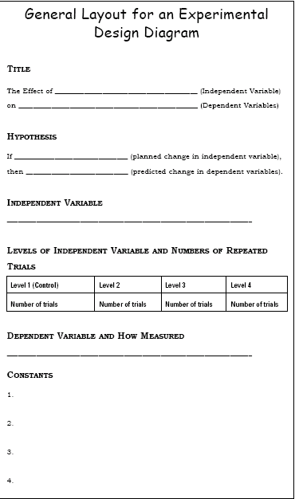

Slide 16
Formulate a Hypothesis
After talking with others and conducting further research, he comes up with a hypothesis.
“If more sugar is added, then the bread will rise higher.”

Slide 17
Hypothesis
The hypothesis is an educated guess about the relationship between the independent and dependent variables.

Slide 18
Independent Variable
The independent, or manipulated variable, is a factor that’s intentionally varied by the experimenter.
John is going to use 25g., 50g., 100g., 250g., 500g. of sugar in his experiment.

Slide 19
Dependent Variable
The dependent variable, is the factor that may change as a result of changes made in the independent variable.
“The independent effects the dependent.”
In this case, it would be the size of the loaf of bread.

Slide 20
Experiment
His teacher helps him come up with a procedure and list of needed materials.
She discusses with John how to determine the control group.

Slide 21
Control Group
In a scientific experiment, the control is the group that serves as the standard of comparison.
Most often the control group is a “no treatment" group.

Slide 22
Control Group
The control group is exposed to the same conditions as the experimental group, except for the variable being tested.
All experiments should have a control group.

Slide 23
Control Group
Because his grandmother always used 50g. of sugar in her recipe, John is going to use that amount in his control group.

Slide 24
Constants
John’s teacher reminds him to keep all other factors the same so that any observed changes in the bread can be attributed to the variation in the amount of sugar.

Slide 25
Constants
The constants in an experiment are all the factors that the experimenter attempts to keep the same.

Slide 26
Constants
They might include:
Other ingredients to the bread recipe, oven used, rise time, brand of ingredients, cooking time, type of pan used, air temperature and humidity where the bread was rising, oven temperature, age of the yeast…

Slide 27
Experiment
John writes out his procedure for his experiment along with a materials list in his journal.

Slide 28
Trials
Trials refer to replicate groups that are exposed to the same conditions in an experiment.
John is going to test each sugar variable 3 times.

Slide 29
Collect and Analyze Results
John comes up with a table he can use to record his data.
John gets all his materials together and carries out his experiment.

Slide 30
Size of Baked Bread (LxWxH) cm³
Size of Bread Loaf (cm³)
Trials
Amt. of Sugar (g.) | 1 | 2 | 3 | Average Size (cm³)
25 | 768 | 744 | 761 | 758
50 | 1296 | 1188 | 1296 | 1260
100 | 1188 | 1080 | 1080 | 1116
250 | 672 | 576 | 588 | 612
500 | 432 | 504 | 360 | 432
Control group

Slide 31
Collect and Analyze Results
John examines his data and notices that his control worked the best in this experiment, but not significantly better than 100g. of sugar.

Slide 32
Conclusion
John rejects his hypothesis, but decides to re-test using sugar amounts between 50g. and 100g.

Slide 33
Experiment
Once again, John gathers his materials and carries out his experiment.
Here are the results.

Slide 34
Size of Baked Bread (LxWxH) cm³
Size of Bread Loaf (cm³)
Trials
Amt. of Sugar (g.) | 1 | 2 | 3 | Average Size (cm³)
50 | 1296 | 1440 | 1296 | 1344
60 | 1404 | 1296 | 1440 | 1380
70 | 1638 | 1638 | 1560 | 1612
80 | 1404 | 1296 | 1296 | 1332
90 | 1080 | 1200 | 972 | 1084
Control group

Slide 35
Conclusion
John finds that 70g. of sugar produces the largest loaf.
His hypothesis is accepted.

Slide 36
Communicate the Results
John tells his grandmother about his findings and prepares to present his project in Science class.

